Slide 1
Session 2 – Nyaya
(Philosophy of Logic & Reasoning:
Verbal Testimony)
1) Revision of Session 1 : Perception & Inference
2) Verbal Testimony : Sabda
3) Scientifically verifiable facts of Indian Verbal Testimony

Slide 2
II Verbal Testimony (Sabda) : Instructive assertion of a reliable person that is, one who is possessed of true knowledge and is truthful.
The validity of verbal knowledge depends upon two conditions:
The meaning of the statement must be perfectly understood,
The statement must be the expression of a trustworthy person, that is, an apta.
Notes:
Samanya : Is Man mortal. Personhood.
Association : Food looks delicious, Stone looks hard, Coldness of ice

Slide 3
There are two main ways of classifying sabda, or testimony.
1. The first category consists of the trustworthy assertions of ordinary persons, saints, sages, and scriptures on matters related to the perceptible objects of the world. Examples are the evidence given by expert witnesses in court, the statements of reliable physicians about physiology, and scriptural declarations concerning the performance of certain rites.
2. The second type of testimony consists of the trustworthy assertions of persons, saints, sages, and scriptures on matters concerning the supersensible realities. Examples are a physicist's assertions about atoms, a nutritionist's statements regarding vitamins, a prophet's instructions on virtue, and scriptural statements about God and immortality.

Slide 4

How can
a child
know ?………

Slide 5
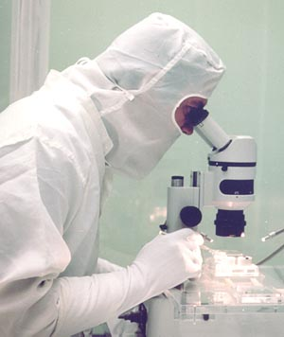
We will check your genes and tell you who your father is in 800 years.
Medical test
by Genetic Finger print takes 800 years to identify a
lot of 200 men
one of whom is
Likely to be your
Father.
Inductive Knowledge

Slide 6
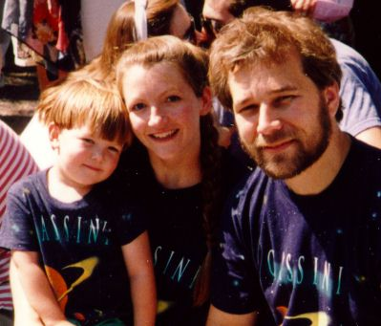

Just ask your mother and know who your father is!
Deductive Knowledge

Slide 7
VEDIC KNOWLEDGE
Revealed absolute Truth
Every word unchanged eternally
SRUTI
SMRTI
Composed by sages
Wording may change from age to age
VEDAS
Rg, Yajur,
Sama, Atharva
UPAVEDAS
Dhanurveda
Ayurveda, etc.
VEDANGAS
Ritual Sutras
Connected to
Kalpa-vedanga
Tantras
Spoken by Lord
Siva to Parvati
Pancaratras
Puranas
Itihasas
Six Darshanas
Samhitas
mantras
Kalpa
ritual details
Srauta Sutras
explains
public yajnas
Vaisnava
worship
18 Major
Brahmanas
ritual explanation
of mantras
Siksa
pronunciation
Grhya Sutras
explains
home yajnas
18 Minor
Tamasic
Aranyakas
esoteric explanation
of mantras
Vyakarana
grammar
Dharma Sutras
Law books
Rajasic
Upanisads
Jnana-kanda
philosophy of Brahman
Nirukta
etymology
Dharma Sastras
including Manu-
samhita and others
Sattvic
Chandas
meters
Jyotisa
astronomy-time
calculation
Vedanta
(Vyasa)
(Metaphysics)
theology of
Upanisads
Mimamsa
(Jaimini)
(Hermeneutics)
interpreting
scriptural texts
Nyaya
(Gautama)
(Epistemology, logic)
philosophy of
knowledge
including logic
Vaisesika
(Kanada)
(Metaphysics)
philosophy of
existence
Yoga
(Patanjali)
(Sadhana)
Sankhya
(Atheist Kapila)
(Metaphysics)
sisters
sisters
sisters

Slide 8
Axiomatic Truth
Self Evident Theory which requires no proof
Axiomatic truths in modern science:
Eg. Definition of a Point – A circle with radius zero
Eg. Imaginary no. “i” - Cannot be plotted
Both are beyond proof in theory but they exist in reality.
K
N
O
W
L
E
D
G
E
S

Slide 9
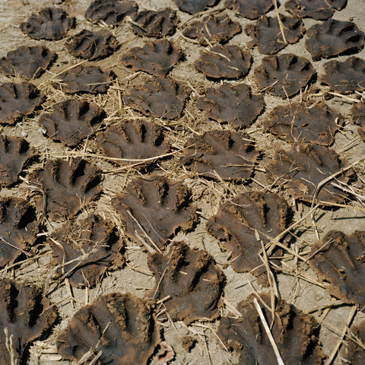
Axiomatic Truth
Modern science confirms Vedic truths
Cow Dung
K
N
O
W
L
E
D
G
E
S

Slide 10
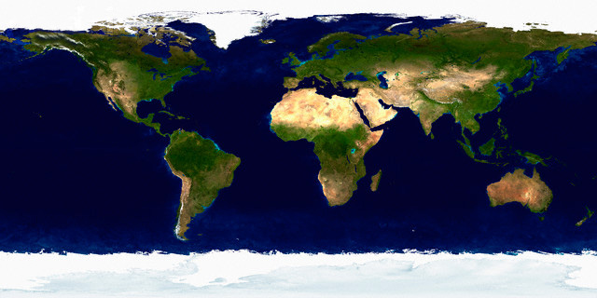
Axiomatic Truth
Modern science confirms Vedic truths
Bhugol
K
N
O
W
L
E
D
G
E
S

Slide 11

Axiomatic Truth
Modern science confirms Vedic truths
Plants have Life
K
N
O
W
L
E
D
G
E
S

Slide 12
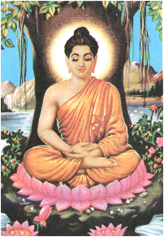
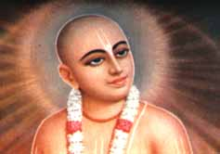
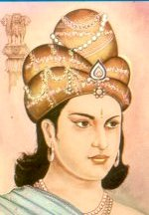
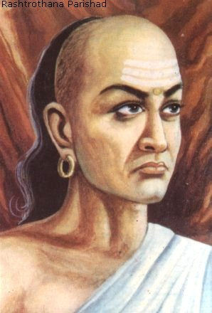
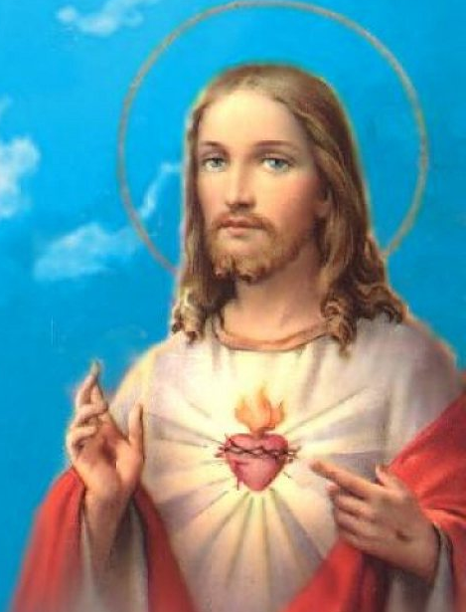
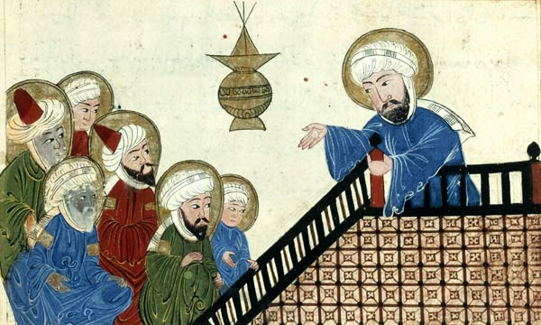
Vedic predictions
Vedas have predicted the birth of great personalities
Buddha (SB 1.3.24)
Chanakya (SB 12.1.11)
Ashoka (SB 12.1.12)
Caitanya Mahaprabhu
(Mahabharata 127.92.75, SB 11.5.32)
Christ , Mohammed (Bhavishya puran,
Atharva veda, kanda 20, shukta 127)

Slide 13





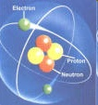

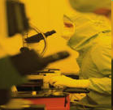

If we accept axioms in Science, then what aboutVedic axioms?
There is no science without axioms
Imaginary number ‘i’
Heisenberg’s uncertainty principle
Third Law of Thermodynamics

Slide 14

Discover the Glory of India
Notes:
World moves to Yoga, Vasstu and Indian astrology based on its astronomy.

Slide 15
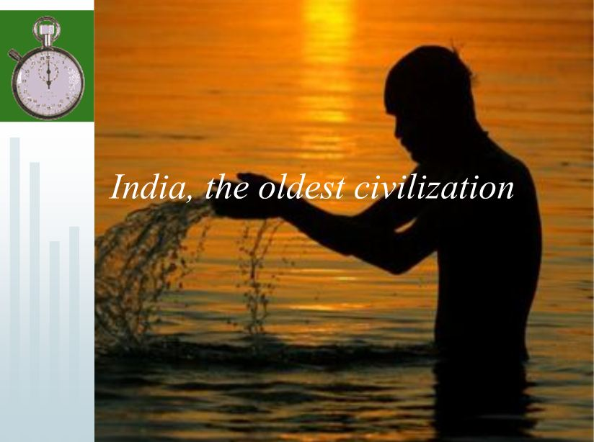

Slide 16
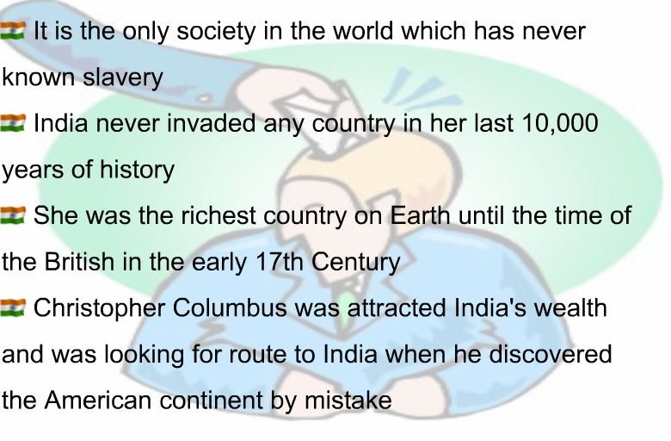
Bharat
Notes:
You can tell what is bharat?
Speciality of bharat. Bharat compared to Rome/ Greece/ Mahabharat version of how kings are conquered.

Slide 17
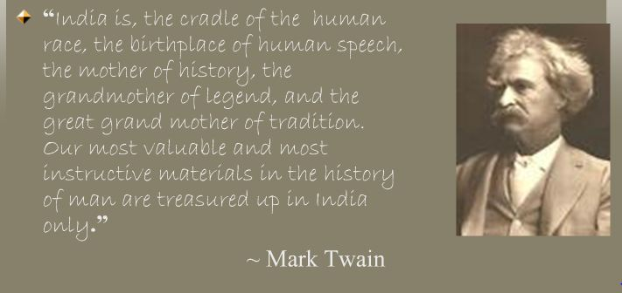
Glories of India

Slide 18
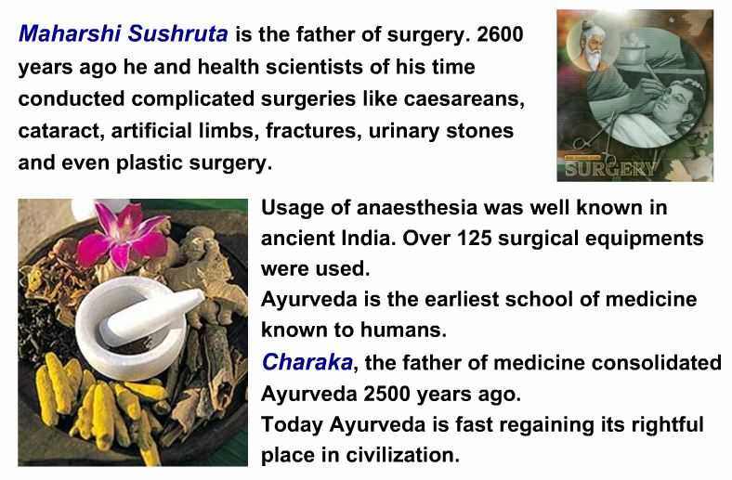
Glory of India :Ayurveda
Notes:
SB detail of Embrology. Examples from Proof of Vedic culture global existence of plastic surgery in ‘Gentlemans magazine’ Maratha driver Cowasjee of British army whose nose and ears were chopped by Tipu. In pune Hindu Ayurvedic surgeon furnished him with new nose. Thomas Cruso and James Trindlay were fascinated witnesses. They say it was normal in India.

Slide 19
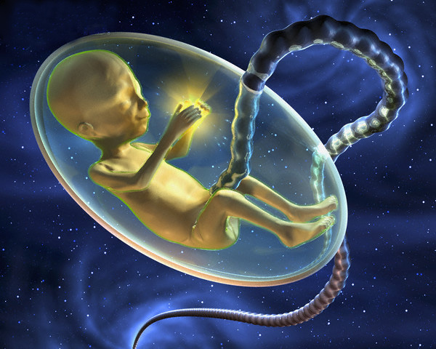
Modern science confirms Vedic truths
Human Embryology
K
N
O
W
L
E
D
G
E
S

Slide 20
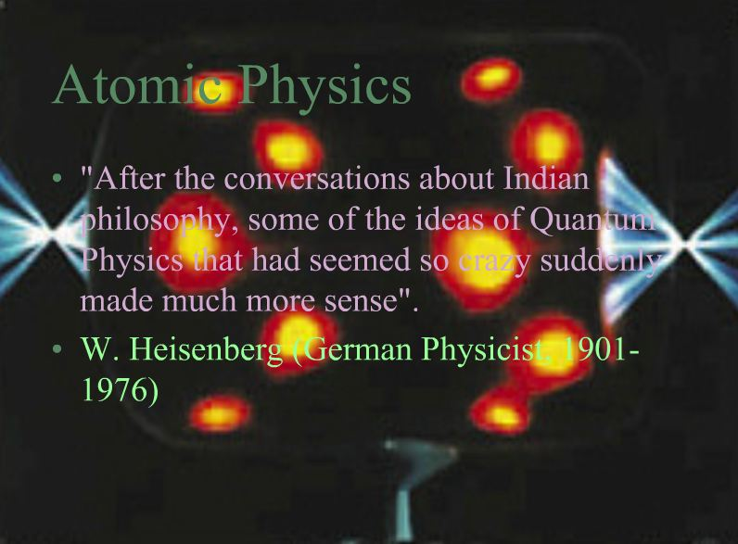

Slide 21
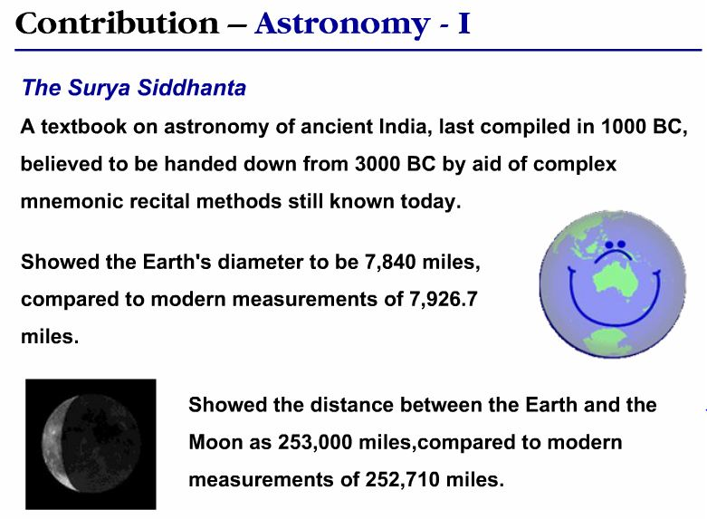
Notes:
Purpose of Astronomy was astrology in Vedic Sciences. Starting Date of Kali yuga calculation.

Slide 22
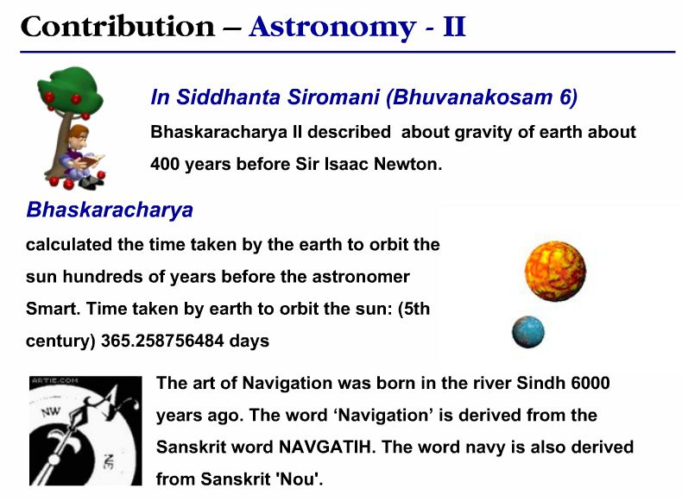

Slide 23
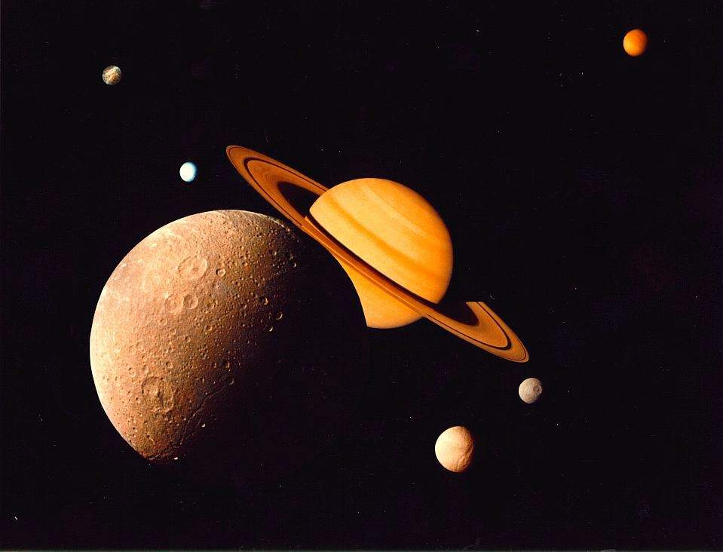
ASTRONOMY - 1
1000 Years Before Copernicus
Copernicus published his theory of the revolution of the Earth in 1543.
A thousand years before him, Aryabhatta in 5th century (400-500 CE) stated that the Earth revolves around the sun, "just as a person travelling in a boat feels that the trees on the bank are moving, people on earth feel that the sun is moving".
In his treatise Aryabhatteeam, he clearly states that our earth is round, it rotates on its axis, orbits the sun and is suspended in space and explains that lunar and solar eclipses occur by the interplay of the sun, the moon and the earth

Slide 24
ASTRONOMY – 2
The Law of Gravity - 1200 Years Before Newton
The Law of Gravity was known to the ancient Indian astronomer Bhaskaracharya. In his Surya Siddhanta, he notes:
"Objects fall on earth due to a force of attraction by the earth. therefore, the earth, the planets, constellations, the moon and the sun are held in orbit due to this attraction".
It was not until the late 17th century in 1687, 1200 years later, that Sir Isaac Newton rediscovered the Law of Gravity.

Slide 25
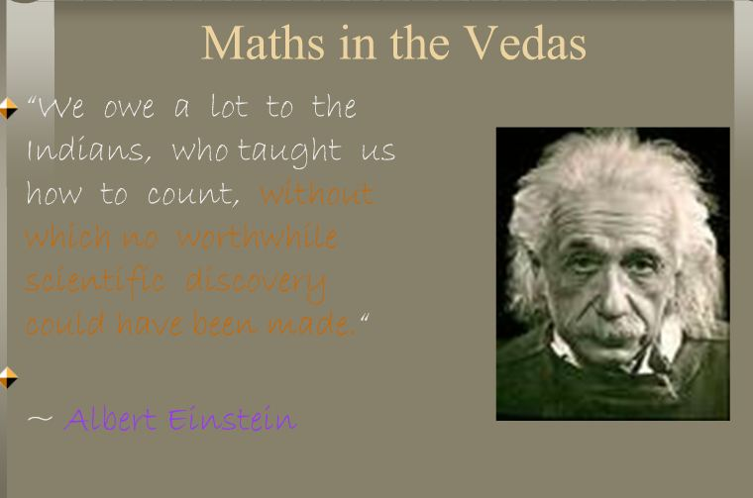

Slide 26
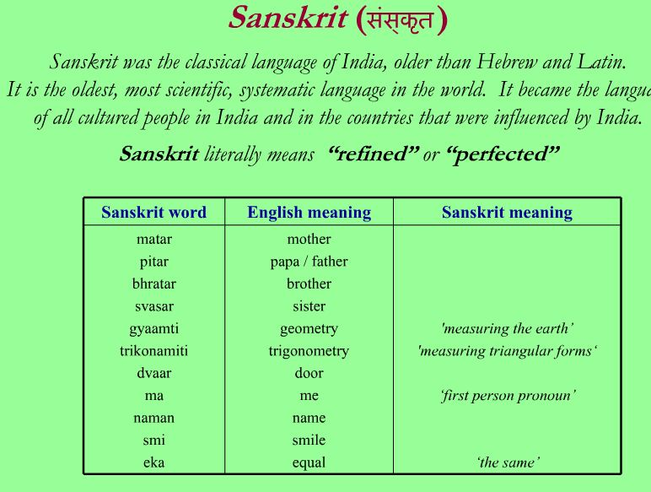
Notes:
Further examples from Proof of Vedic culture’s global existence. For sanskrit words in english. Months of the year : September, November etc. Page 30 and 76-80 of Vedic culture book.

Slide 27
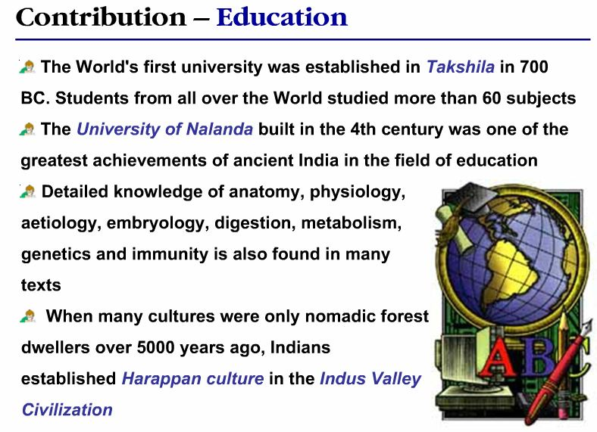

Slide 28
Glory Of Vedic India : Advanced Mathematics
Indians discovered Arithmetic and Geometric progression. Arithmetic progression is explained in Yajurveda.
Govindaswamin discovered Newton Gauss Interpolation formula about 1800 years before Newton.
Vateswaracharya discovered Newton Gauss Backward Interpolation formula about 1000 years before Newton.

Slide 29
Glory Of Vedic India : Advanced Mathematics
Parameswaracharya discovered Lhuiler’s formula about 400 years before Lhuiler.
Nilakanta discovered Newton’s Infinite Geometric Progression convergent series.
Positive and Negative numbers and their calculations were explained first by Brahmagupta in his book Brahmasputa Siddhanta.
Aryabhatta also propounded the Heliocentric theory of gravitation, thus predating Copernicus by almost one thousand years.

Slide 30
Glory Of Vedic India : Mathematics
The value of "pi" was first calculated by Boudhayana, and he explained the concept of what is known as the Pythagorean Theorem. He discovered this in the 6th century long before the European mathematicians. This was ‘validated’ by British scholars in 1999.
Algebra, trigonometry and calculus came from India. Quadratic equations were propounded by Sridharacharya in the 11th century.
The largest numbers the Greeks and the Romans used were 106 whereas Hindus used numbers as big as 10⁵³ with specific names as early as 5000 BC during the Vedic period. Even today, the largest used number is Tera: 10¹².

Slide 31
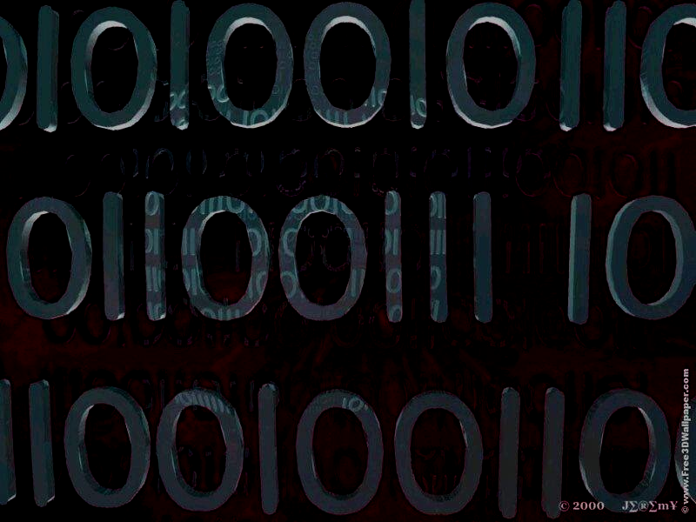
Mathematics-1
Zero –The Most Powerful Tool
India invented the Zero, without which there would be no binary system. No computers! The earliest recorded date, an inscription of Zero on Sankheda Copper Plate was found in Gujarat, India (585-586 CE).

Slide 32

Mathematics-2
Invention of Geometry
Euclid is credited with the invention of Geometry in 300 BCE while the concept of Geometry in India emerged in 1000 BCE, from the practice of making fire altars in square and rectangular shapes.

Slide 33
Mathematics-3
The Value of PI in India
The ratio of the circumference and the diameter of a circle are known as Pi, which gives its value as 3,1428571. The old Sanskrit text Baudhayana Shulba Sutra of the 6th century BCE mentions this ratio as approximately equal to 3. Aryabhatta in 499, CE worked the value of Pi to the fourth decimal place as 3.1416. Centuries later, in 825 CE Arab mathematician Mohammed Ibna Musa says that "This value has been given by the Hindus (Indians)".

Slide 34
Mathematics-4
Pythagorean Theorem or
Baudhayana Theorem?
The so-called Pythagoras Theorem – the square of the hypotenuse of a right-angled triangle equals the sum of the square of the two sides – was worked out earlier in India by Baudhayana in Baudhayana Sulba Sutra. He describes: "The area produced by the diagonal of a rectangle is equal to the sum of the area produced by it on two sides."
[Note: Greek writers attributed the theorem of Euclid to Pythagoras]

Slide 35

ATOMIC PHYSICS
Sage Kanad (circa 600 BCE) stated that every object in creation is made of atoms that in turn connect with each other to form molecules nearly 2,500 years before John Dalton.
The eminent historian, T.N. Colebrook said, "Compared to scientists of Europe, Kanad and other Indian scientists were the global masters in this field.“
Notes:
Video to be played. Talk about Indian History and Aryan Invasion, Indus-Saraswat civilization, Pillar at Ashoka and so on. Vob2 to play from 24.22 to 32. *=(8 min)
Para and Apara vidya section of the Vedas is the conclusion of this part of the talk.

